Slide 1
Seed Data

Slide 2
What is Seed Data?
This is when you add data to your database by default
Allows you to preload your database with a set of data ready for you to test other functions

Slide 3
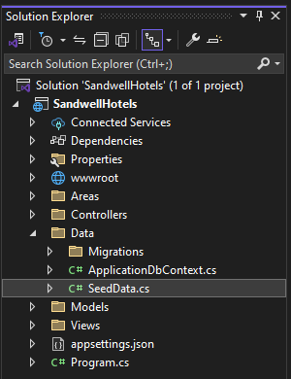
Add a new class in the Data folder called SeedData

Slide 4
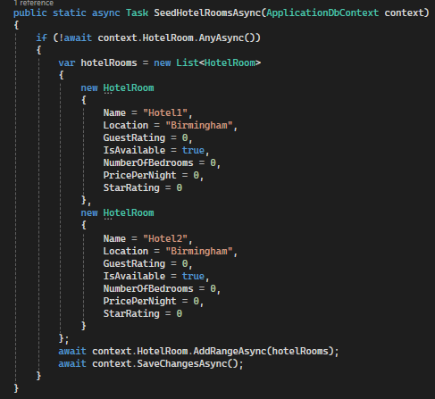
Create a new method in Seed Data.cs called SeedHotelRooms
We first check to see if there is any data in Hotel Rooms table
If there is none, we create a list of the different rooms we want to add in to the table
Then we use .AddRange() and pass the list through to add those rooms
Finally, we save the changes

Slide 5

Add these lines of code to your Program.cs
This makes it so that it will run when the program is started and built

Slide 6
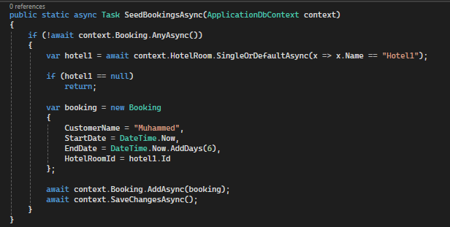
Seed Bookings
Slightly different as we need to pass through the hotel room
Similar to the Create Post Method

Slide 7
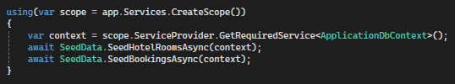
Update the Program.cs

Slide 8
Try It Out

